Slide 1
Open Stub Vertical
A Simple Antenna for VHF/UHF Station
By
Doug Theriault - NO1D

Slide 2
Agenda
VHF/UHF Antenna Options
J-Poles vs an Open Stub J-Pole (OSJ)
Make vs Buy
OSJ Materials and Tools Required
Assembly
Performance
References, Links and Useful Information

Slide 3
Tons of VHF/UHF Antenna Options
Handheld Flexible Antenna, aka: Rubber Duck
Ground Plane
Mobile – Single/Dual Band
Dipole (horiz or vert)
Yagi’s
Loops, Halos, Quads
J-Poles and OSJ
Many options to choose from

Slide 4
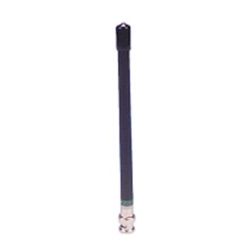
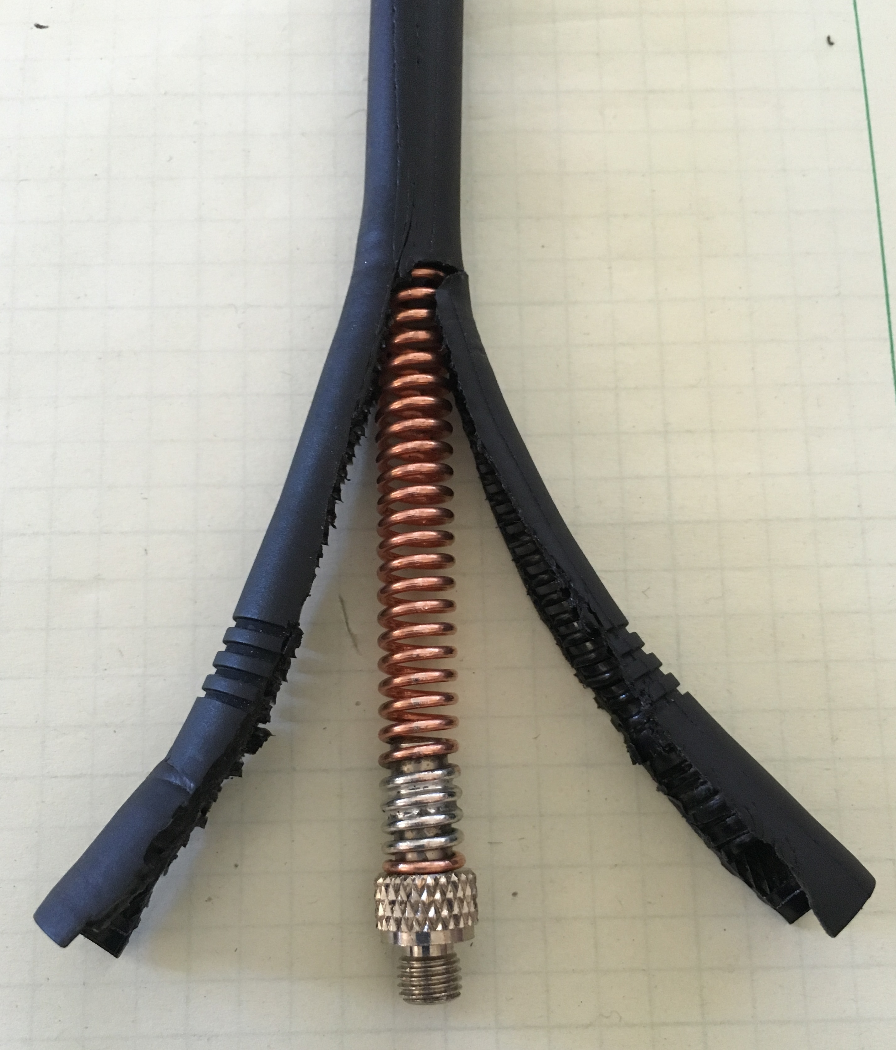
Rubber Duck, Flexible Antenna
They’re ok for a handheld
Compromise antenna
Some say not much better than dummy load
Coil spring center is an inductor
Not for use with mobile rig (although people have tried)

Slide 5
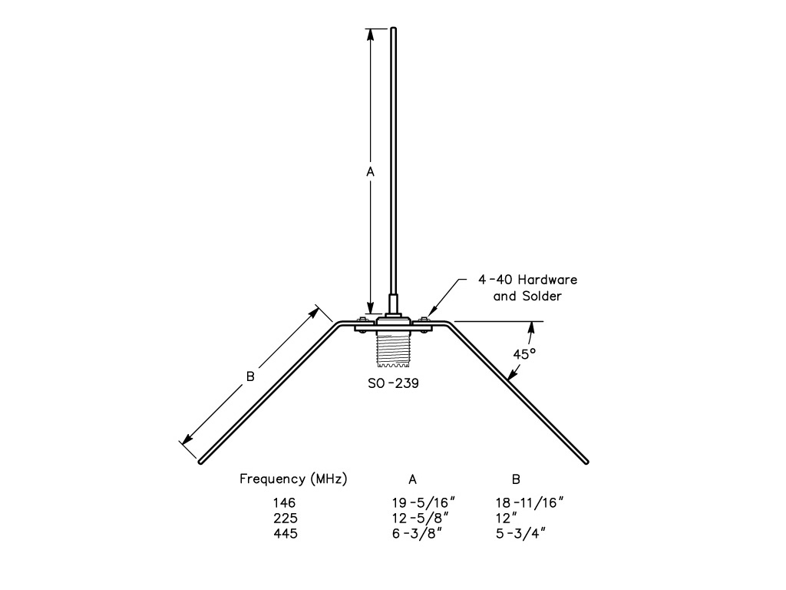
Ground Plane Vertical
Great first antenna
¼ Wavelength
~ 19.25” for 2m
~ 6.375” for 70cm
Easy to make using some #12ga wire and SO-239 chassis connector
Good performance

Slide 6
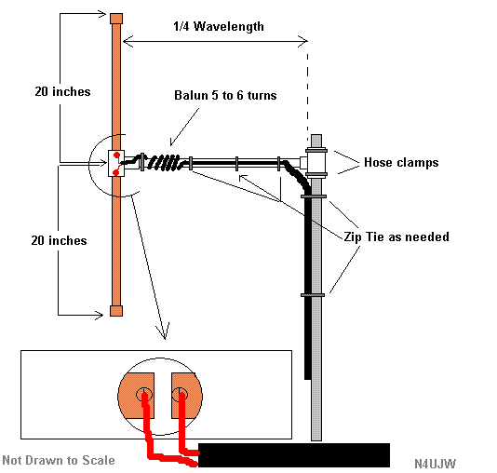
Dipole
Simple to make with piece of coax and some wire
½ Wavelength total
Dipole lengths:
~ 38” (~19” - 20” each leg) 2m
~ 12” (~6” each leg) 70cm
Horiz not as efficient for local VHF/UHF repeaters
Vertical mounting is ideal, but feedline coupling could be a problem; needs to run out perpendicular to dipole.

Slide 7
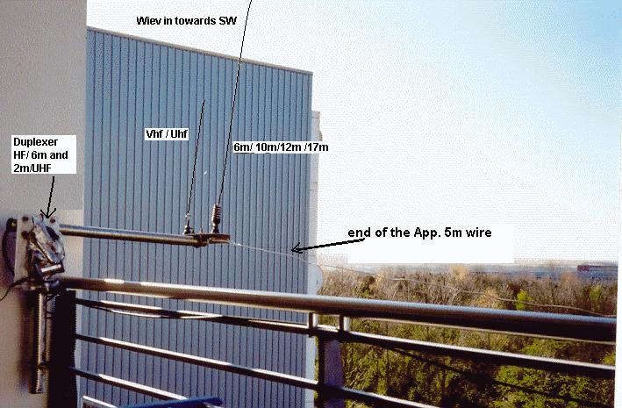
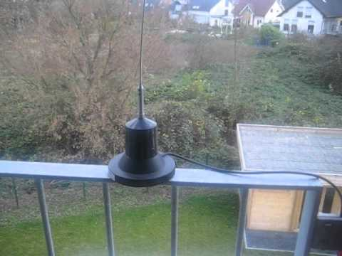
Use Mobile Antenna
Many good options
Do require ground plane to be efficient
Can be stealthy say on a balcony railing

Slide 8
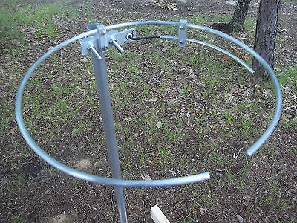
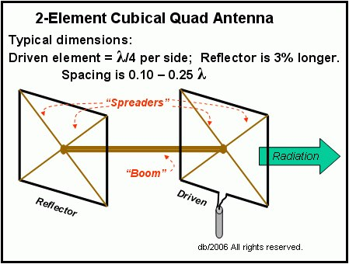
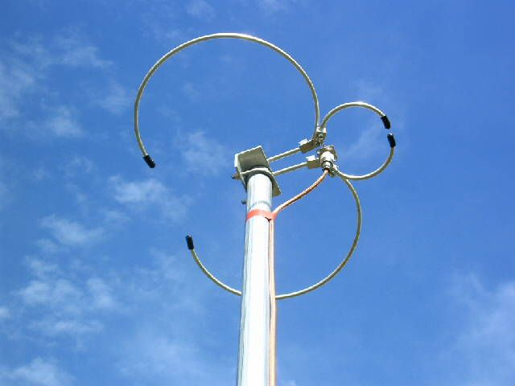
Halo’s and Quads

Slide 9
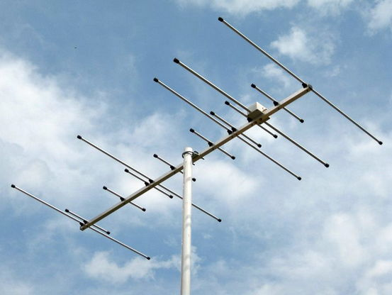
Yagi Beam Antennas
High gain, very directional
Can be used vertically polarized
Not very stealthy
Rotators desired which complicates deployment

Slide 10
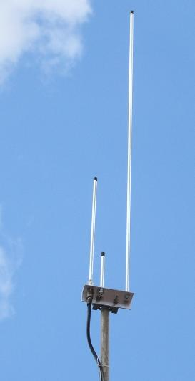
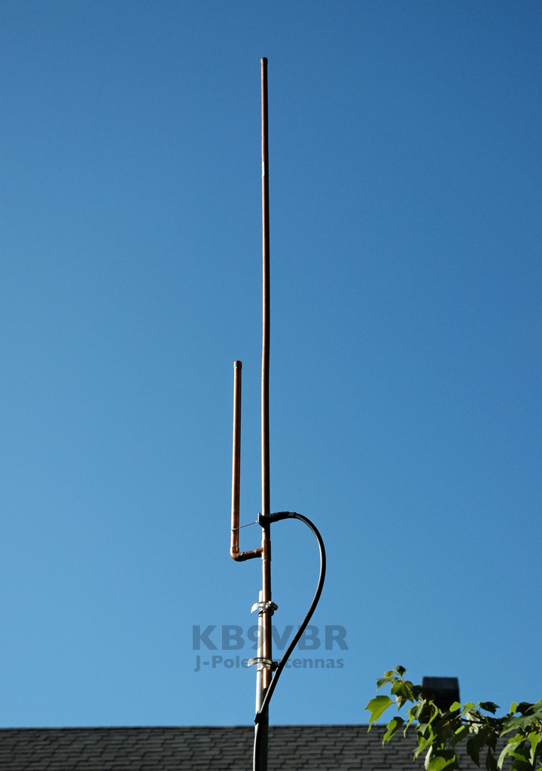
J-Poles, Open Stub J-Pole (OSJ) or Open Stub Vertical
Can be stealthy vertical antennas
People report good performance
Many various build techniques
Copper Pipe
Rod stock
Wire

Slide 11
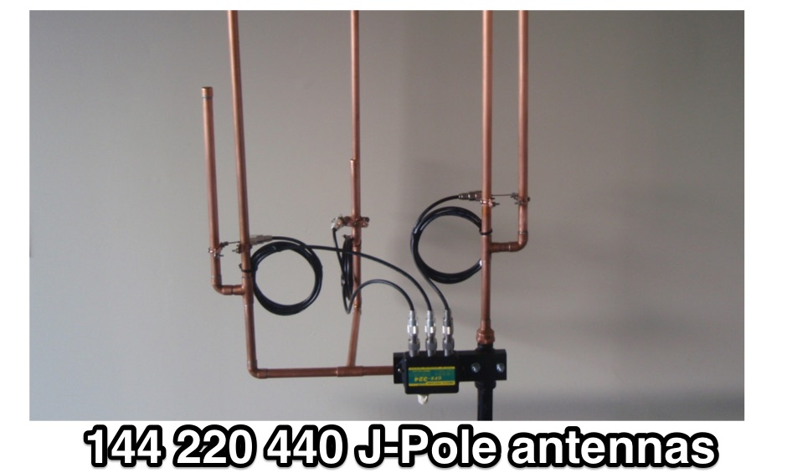
Multi-Band J-Pole

Slide 12
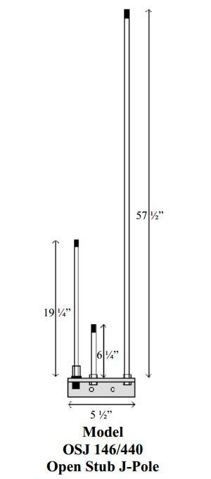
Open Stub J-Pole - OSJ
Needed something relatively stealthy
Able to mount on 4-5 ft pole
Hide it near tree or house
VHF & UHF capable
Relatively easy to build

Slide 13
Make vs Buy
Buy
Easy, Fast
Someone else proved design
Needs special materials
Perhaps not mechanically inclined
Arrow Antennas $49
Make
Creative use of materials; from wire to pipe/conduit.
Mark up on antennas can be high
Learning experience
Pride of building it yourself
Leverage designs from other hams and then blaze your own trail
Experimentation is fun and enlightening
Its not that difficult !

Slide 14
Materials for an OSJ
1.5” Aluminum Angle Stock
3/8” Aluminum Rod
3/8”-16 or 3/8”-24” threaded coupler (optional)
U-Bolt or equiv for mounting pole
Mounting pole; metal, wood, pvc
Hack Saw, Pliers/Wrenches
Die tool to create threads on cut rods; 3/8”-16 & 3/8”-24
Nuts and star/lock washers (optional)
Drill and bits
File and or Grinder
Design is same as Arrow VHF/UHF Open Stub
Can find majority of materials at Home Depot, Lowes or local scrap dealers
PL259 to 3/8” thread can be found on Amazon and many RF Parts stores online

Slide 15
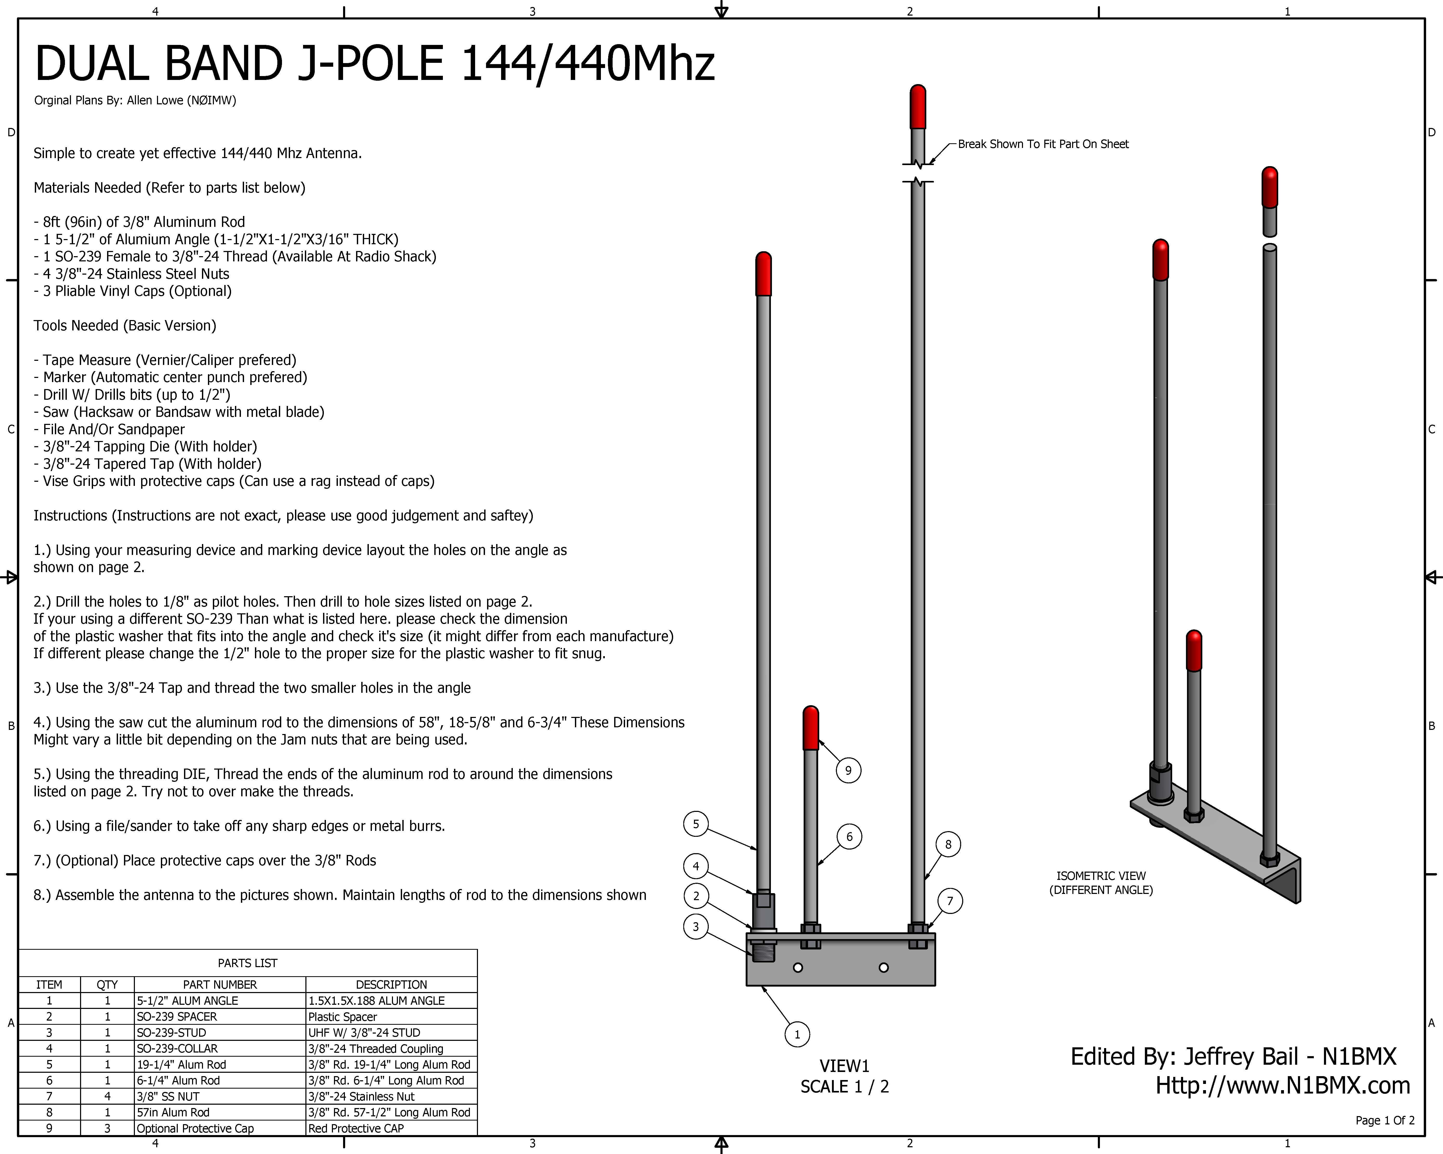

Slide 16
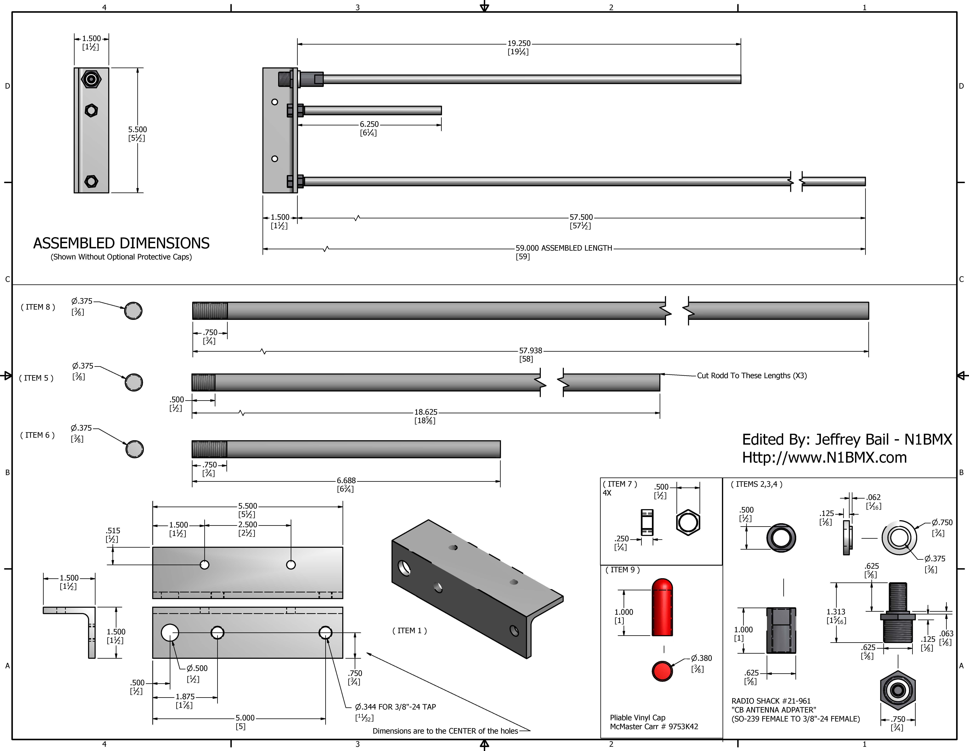

Slide 17
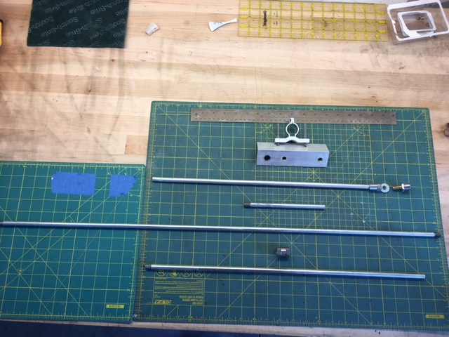
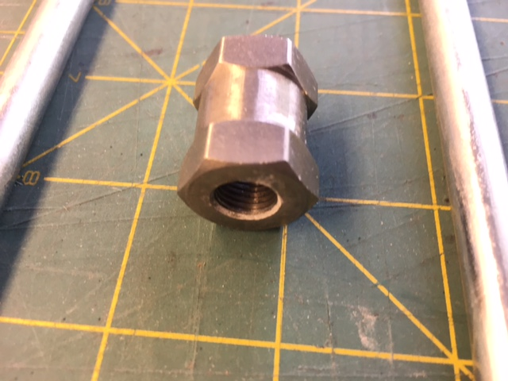
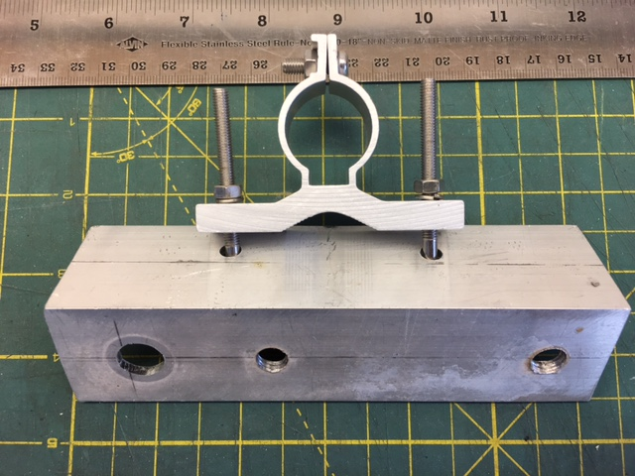
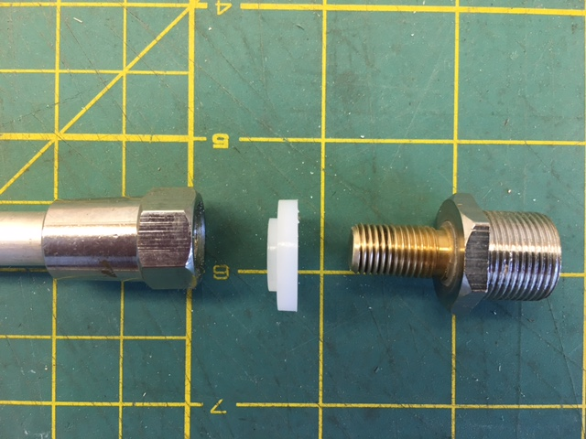
Major Components

Slide 18
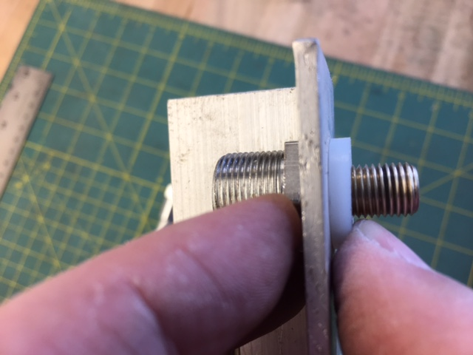
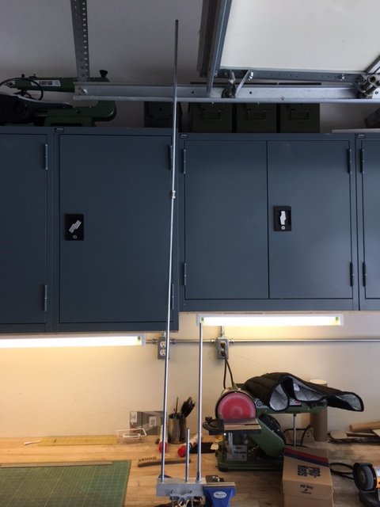
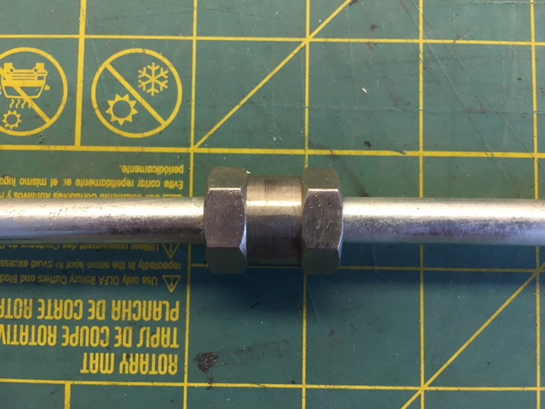
Assembly

Slide 19
Tuning and Pruning
Keep vertical elements straight for proper spacing
If you use nuts to hold vertical elements, give yourself room for adjustments; 3/4”
Some people add threaded screws to top of elements to fine tune lengths
Start with VHF tuning first; you should see UHF have good SWR w/o needing any adjustments of driven element or large reflector.
UHF tuning to small rod only
Stay away from metal objects when tuning

Slide 20
Mounting
Angle bracket is connected to Coax shield
Metallic or insulated (PVC) pole can be used
Re-Tuning may be needed after mounting if using metallic post

Slide 21
Performance
Using at home QTH on both VHF/UHF
Handles 50W fine
VHF SWR was 1.2:1, UHF higher (1.8:1)
Limited at my QTH based on mounting too close to house which limits access into Prescott .88 machine (from PV)

Slide 22
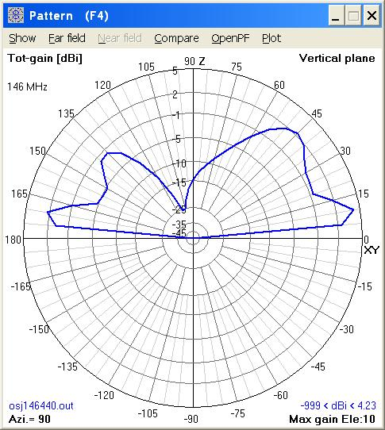
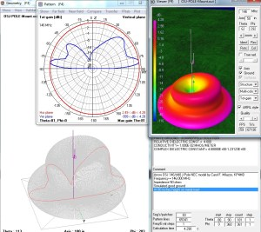
Antenna Modeling

Slide 23
Notes / Comments
Cut lengths longer than needed and trim/grind to get a good match
Important to cut your threads straight; if they’re crooked so will be your elements and will effect matching and pattern
Painting will detune the antenna; if you paint for stealthy look, measure and possibly re-tune; non-conductive paints
Keep away from other metallic surfaces; at least 1 wavelength or more.
Installing next to Stucco wall; beware there’s mesh wire in the wall which will act as reflector and de-tune antenna a bit

Slide 24
References / Links
http://nt1k.com/blog/2011/open-stub-j-pole-project-completed-many-times/
https://www.youtube.com/watch?v=PR8r-5jkygY
ARRL Antenna Handbook
www.arrowantennas.com
Great Info on Modeling by KP4MD: http://www.qsl.net/kp4md/modeling.htm

Slide 25
Thank You for Attending
Questions feel free to contact me:
NO1D.DOUG@GMAIL.COM
YARC
Find me on Mt. Union UHF, 447.650 -, 100.0 hz where I’m using an OSJ
Or @ IRLP Node 7100

